Slide 1


Slide 2

Introduction
Blink Commerce Private Limited, aka Blinkit and formerly Grofers, is an Indian quick commerce company owned by Eternal Limited.
It was founded in December 2013 and is based in Gurgao.
Blinkit's employees then secure the items from their warehouse and deliver the items to the consumer within 10 minutes. By November 2021, the company was delivering 125,000 orders every day.
Blinkit currently operates in more than 30 cities in India. By the end of 2021, the company had raised about US $630 million from investors including Soft Bank, Tiger Global and Sequoia Capital.

Slide 3

Sales & Profit Analysis
The retail sales and profit analysis on Blinkit conducted a comprehensive analysis to uncover actionable insights.
Tools used:
a)MySQL: data cleaning, handling missing values
b)Power BI: Interactive dashboards and visualizations
Dataset source: Kaggle – Blinkit Sales Dataset

Slide 4

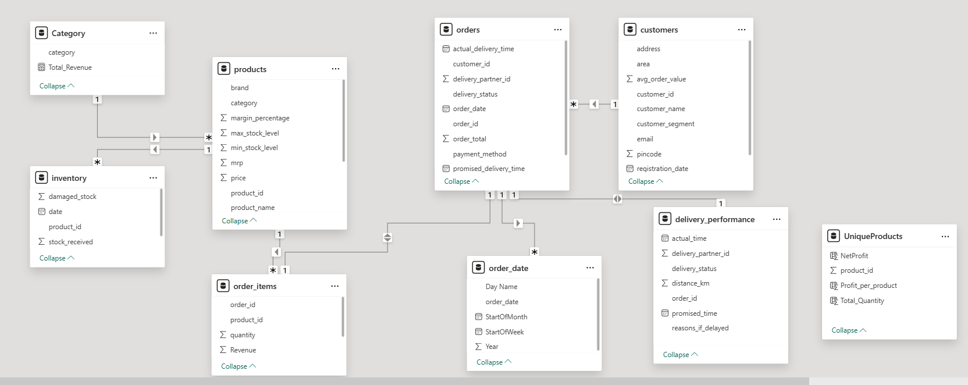
Data Model Relationships

Slide 5
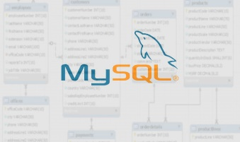
MySQL Data Cleaning & Preparation
Removed duplicated, handled null values using IS NULL() and COALESCE()
Standardized Formats using date() and datetime()
Replacing missing values in key columns like quantity, per unit price, revenue and profit.
Verified data consistencies across joins

Slide 6

KPI’s
Total orders, average orders, total sales, total ordered quantity, average customers
Sales by Category
Sales by Products
Net Profit as per product unit price quantity ordered
Gross profit per unit product price
Top 3 category total ordered quantity revenue generated
Total orders by top 3 customer segments

Slide 7
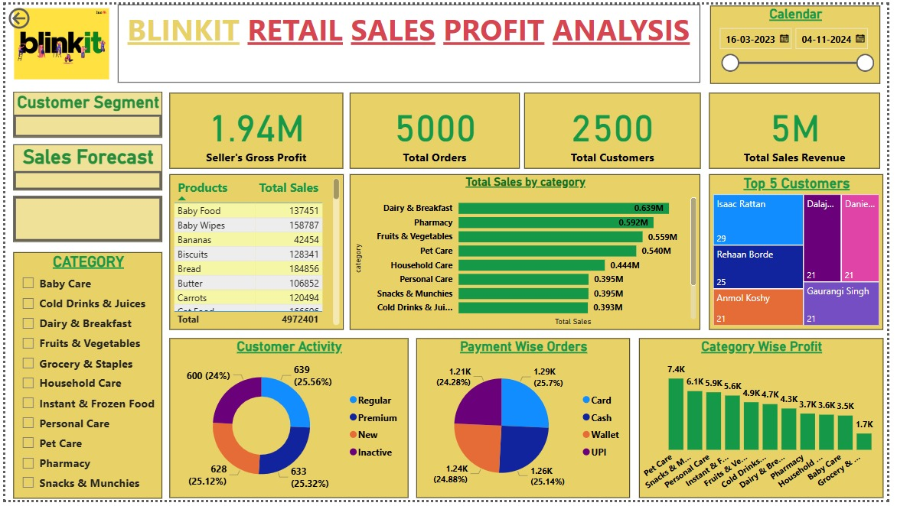
Power BI Interactive Dashboard
Total Revenue, Net Profit, Average Order Value
Monthly and weekly Sales Trends
Slicer filters for time, category, and customer type
Buttons to navigate pages

Slide 8
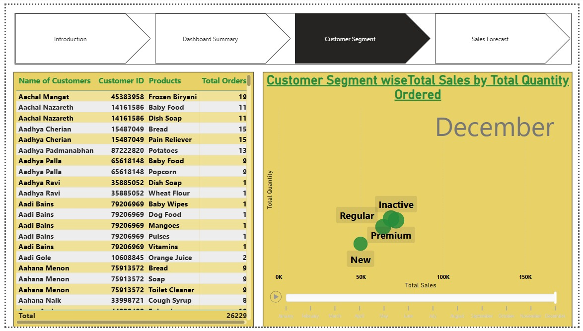

Slide 9
